Slide 1
IND AS 32 - Financial Instrument – Presentation
IND AS 109 - Financial Instrument
IND AS 107 - Financial Instrument – Disclosure
Accounting & Reporting of Financial Instrument

Slide 2
Financial Instrument – Any contract which gives rise to a financial asset to one entity and a financial liability or equity to another entity
Financial Asset - Any asset that is:
(a) Cash;
(b) An equity instrument of another entity;
(c) A contractual right to receive cash or another financial asset from another entity, or to exchange financial assets or financial liabilities with another entity under conditions that are potentially favorable to the entity; or
(d) A contract that may be or will be settled in the entity’s own equity instrument and is not classified as an equity instrument of the entity
Financial Liability - Any liability that is:
(a) A contractual obligation to deliver cash or another financial asset to another entity, or to exchange financial assets or financial liabilities with another entity under conditions that are potentially unfavorable to the entity; or
(b) A contract that will or may be settled in the entity’s own equity instruments and is not classified as an equity instrument of the entity
Equity Instrument - Any contract that evidences a residual interest in the assets of an entity after deducting all of its liabilities
Derivative - Any contract between two parties that derives its value/price from an underlying asset
Definition

Slide 3
Initial Recognition

Slide 4
Except for trade receivables at initial recognition, an entity shall measure a financial asset or financial liability at its fair value plus or minus.
However, if the fair value of the financial asset or financial liability at initial recognition differs from the transaction price, an entity shall use settlement date accounting for an asset that is subsequently measured at amortized cost, the asset is recognized initially at its fair value on the trade date
Despite the requirement at initial recognition, an entity shall measure trade receivables at their transaction price (as defined in Ind AS 115) if the trade receivables do not contain a significant financing component in accordance with Ind AS 115
Initial Recognition

Slide 5
Subsequent Recognition

Slide 6
Category of Financial Assets
Category of Financial Liability
Amortized Cost
Amortized Cost
Fair value through profit and loss
Fair value through profit and loss
Fair value through other comprehensive income

Slide 7
An entity shall classify financial assets as subsequently measured at amortized cost, fair value through other comprehensive income, or fair value through profit or loss on the basis of both:
(a) the entity’s business model for managing the financial assets and
(b) the contractual cash flow characteristics of the financial asset.
Amortized Method - (Held to maturity)
(a) the financial asset is held within a business model whose objective is to hold financial assets in order to collect contractual cash flows and
(b) the contractual terms of the financial asset give rise on specified dates to cash flows that are solely payments of principal & interest on the principal amount outstanding.
Fair value through other comprehensive income - (Intend to sell before maturity)
(a) the financial asset is held within a business model whose objective is achieved by both collecting contractual cash flows and selling financial assets and
(b) the contractual terms of the financial asset give rise on specified dates to cash flows that are solely payments of principal and interest on the principal amount outstanding.
Fair value through profit and loss - (Residual)
A financial asset shall be measured at fair value through profit or loss unless it is measured at amortized cost or at fair value through other comprehensive income Example: Derivatives, held for trading and designated at FVTPL
Classification of Financial Assets
An entity may make an irrevocable election at initial recognition for particular investment in equity instruments

Slide 8
Solely payment of principal and interest – (SPPI Interest)
Principal is the fair value of the financial asset at initial recognition – the principal amount may change over the life of the financial asset (for example, if there are repayments of principal)
Interest elements – consideration consistent with the basic lending arrangement:
▪ time value of money
▪ credit risk
▪ other basic lending risks (for example, liquidity risk)
▪ costs associated with holding the financial asset for a particular period of time
▪ profit margin that is consistent with a basic lending arrangement
Contractual Cash Flow
('SPPI') TEST

Slide 9
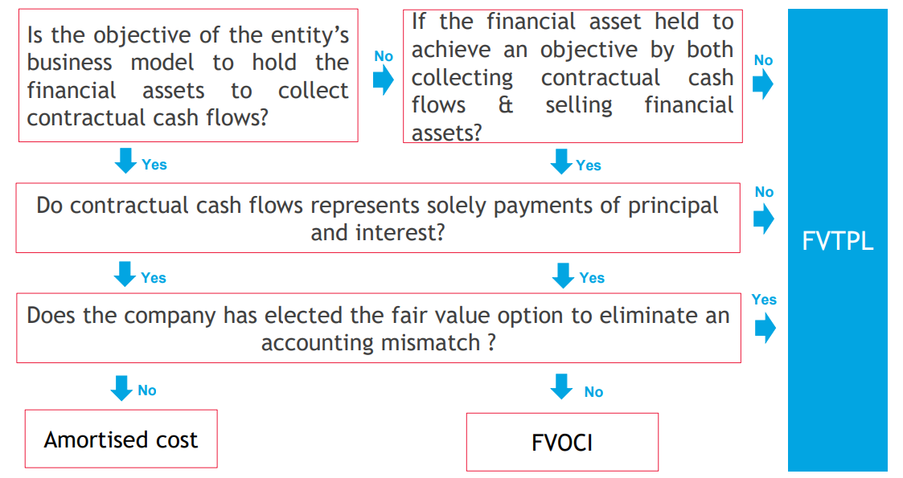
Classification of Financial Asset

Slide 10
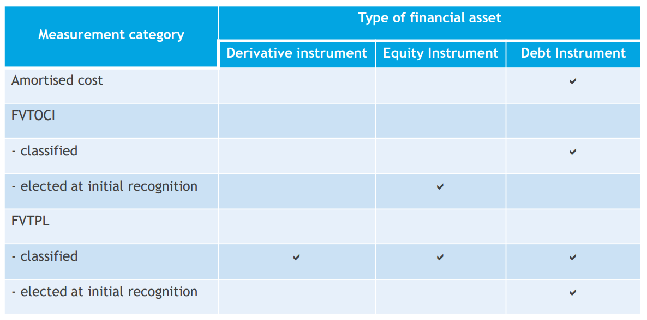
Classification of Financial Asset

Slide 11
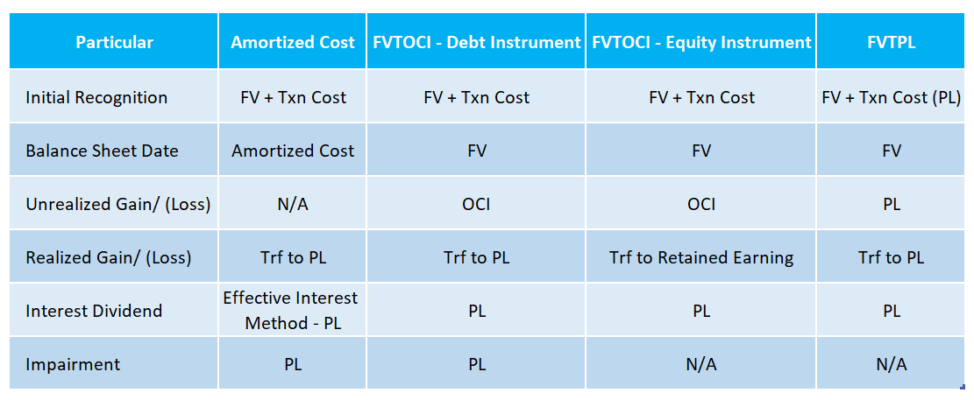
Accounting of Financial Asset
At market terms = Transaction price. Where in off-market price fair value is calculated as per Ind AS 113 (which is usually PV of future cash flow discounted at a fair discounting rate)

Slide 12
An entity shall classify all financial liabilities as subsequently measured at amortized cost, except for:
(a) financial liabilities at fair value through profit or loss. Such liabilities, including derivatives that are liabilities, shall be subsequently measured at fair value.
(b) financial liabilities that arise when a transfer of a financial asset does not qualify for derecognition or when the continuing involvement approach applies
(c) Financial guarantee contracts
(d) Commitments to provide a loan at a below-market interest rate.
(e) Contingent consideration recognized by an acquirer in a business combination to which Ind AS103 applies. Such contingent consideration shall subsequently be measured at fair value with changes recognized in profit or loss
Classification of Financial Liability

Slide 13
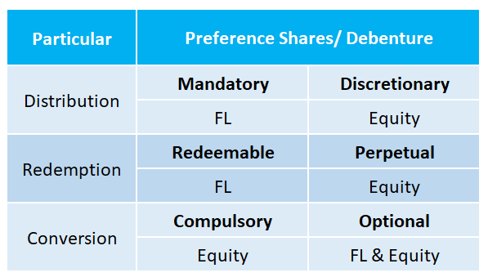
Identification of Financial Liability
Example: 9% Redeemable Pref Shares – FL, Irredeemable bond with discretionary of interest – Equity and 10% Compulsory convertible bond – Hybrid Instrument

Slide 14
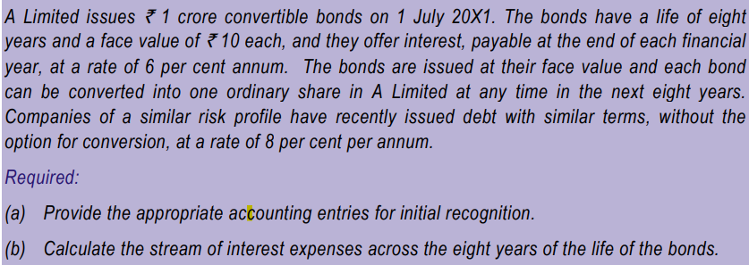
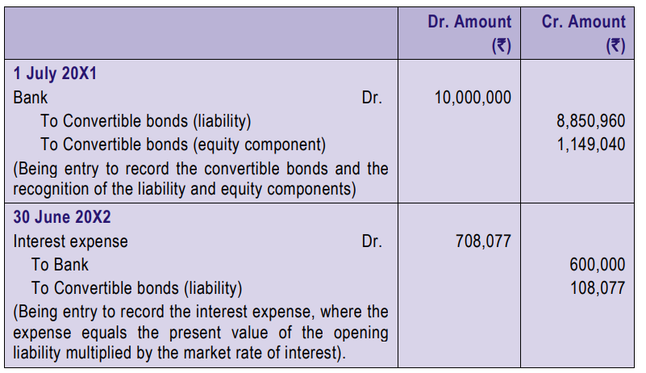

Slide 15
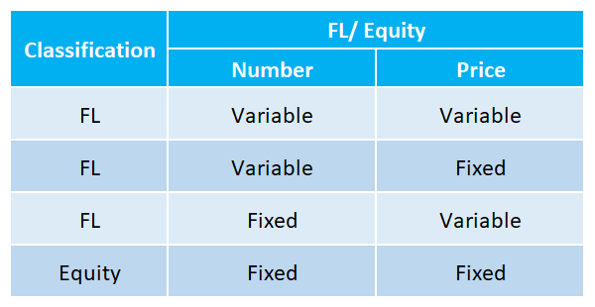
Classification of Financial Liability

Slide 16
Derivative & Hedge Accounting

Slide 17
Derivative Accounting

Slide 18
The objective of hedge accounting is to represent, in the financial statements, the effect of an entity's risk management activities that use financial instruments to manage exposures arising from particular risks that could affect profit or loss (or other comprehensive income, in the case of investments in equity instruments for which an entity has irrevocably elected to present changes in fair value in other comprehensive income
• For hedge accounting purposes, only contracts with a party external to the reporting entity (i.e., external to the group or the individual entity that is being reported on) can be designated as hedging instruments
Objective of Hedge Accounting

Slide 19
Fair value hedge:
Hedge of the exposure to changes in fair value of a recognized asset, liability, unrecognized firm commitment, or a component of any such item, that is attributable to a particular risk and could affect profit or loss.
So here, you have some “fixed item” and you’re worried that its value will fluctuate with the market.
A fixed item means that the item has a fixed value in your accounts and may provide or require a fixed amount of cash in the future.
Example: You issued some bonds with coupon 2% p.a. It’s nice that you always know how much you’ll pay in the future. But you are worried that in the future, the market interest rate will be much lower than 2% and you will be overpaying (in other words, you could get the loan at much lower interest in the future, and you will be paying at a fixed rate of 2%). Therefore, you enter into an interest rate swap to:
@ receive 2% fixed; and
@ pay LIBOR12M + 0.5%.
This is a fair value hedge – you tied the fair value of your interest payments to market rates
Fair Value Hedge Accounting
Hedge accounting is optional

Slide 20
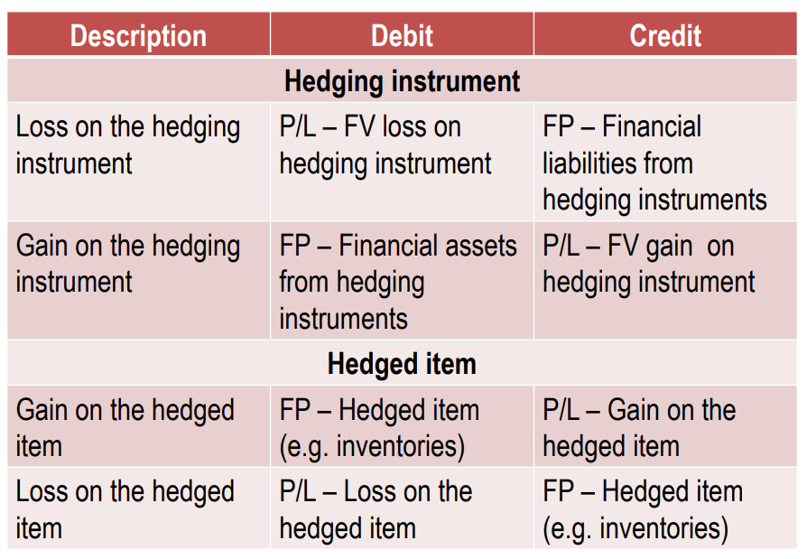
Fair Value Hedge Entry
Hedge accounting is optional

Slide 21
Cash flow hedge
A hedge of the exposure to variability in cash flows that is attributable to a particular risk associated with all or a component of a recognized asset or liability or a highly probable forecast transaction could affect profit or loss.
Here, you have some “variable item” and you’re worried that you might get less or have to pay more in the future than now.
Example: You issued some bonds with coupon LIBOR 12M+0.5%. It means that in the future, you will pay interest in line with the market because LIBOR reflects the market conditions. But you don’t want to pay in line with the market. You want to know how much you will pay in the future, as you need to make some budget, etc. Therefore, you enter into interest rate swap to:
@ receive LIBOR 12M + 0.5%; and
@ pay 2% fixed.
This is cash flow hedge – you fixed your cash flow, and you will always pay 2%
Cash Flow Hedge Accounting
Hedge accounting is optional

Slide 22
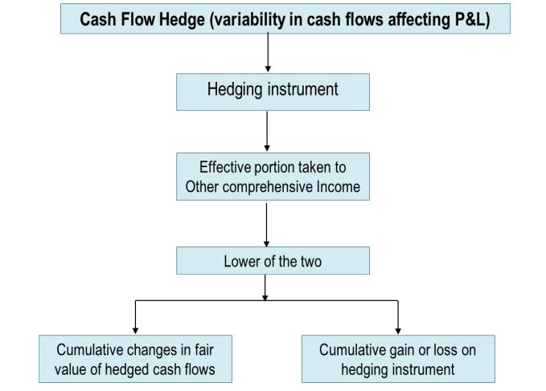
Effective
Portion Cash Flow
Hedge accounting is optional

Slide 23
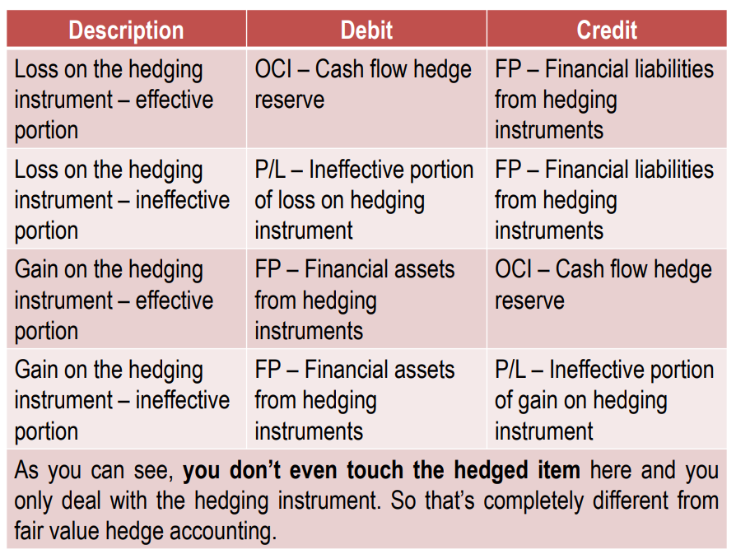
Cash Flow Hedge Entry
Hedge accounting is optional

