Slide 1
Corporate Etiquettes

Slide 2
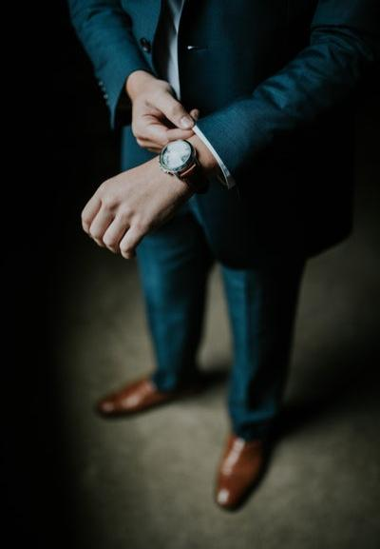
You never get a second chance to make the first impression!!!

Slide 3
INTRODUCTION:
Etiquette has to do with good manners. It's not so much our own good manners, but making other people feel comfortable by the way we behave.
“The conduct or procedure required by good breeding or authority to be observed in social or official life.”

Slide 4
Corporate etiquette
Client service etiquette
Phone etiquette
E-mail etiquette
Business dress etiquette
Office space etiquette
Professional conduct
Interview etiquette
Dining
etiquette
Business
Card
etiquette

Slide 5
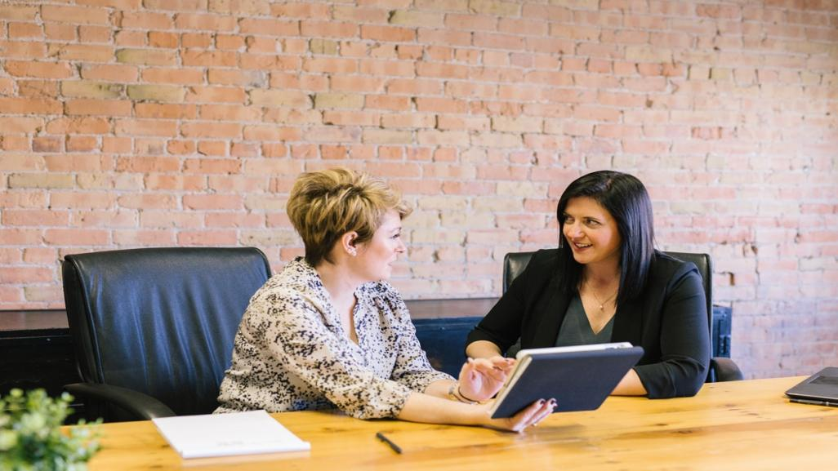
n
Client Service Etiquette
Do not take comments or insult personally
Never interrupt the client
Stay focused
Take responsibility
Patience really is a virtue
Remember the Golden Rule
Ease their pain

Slide 6
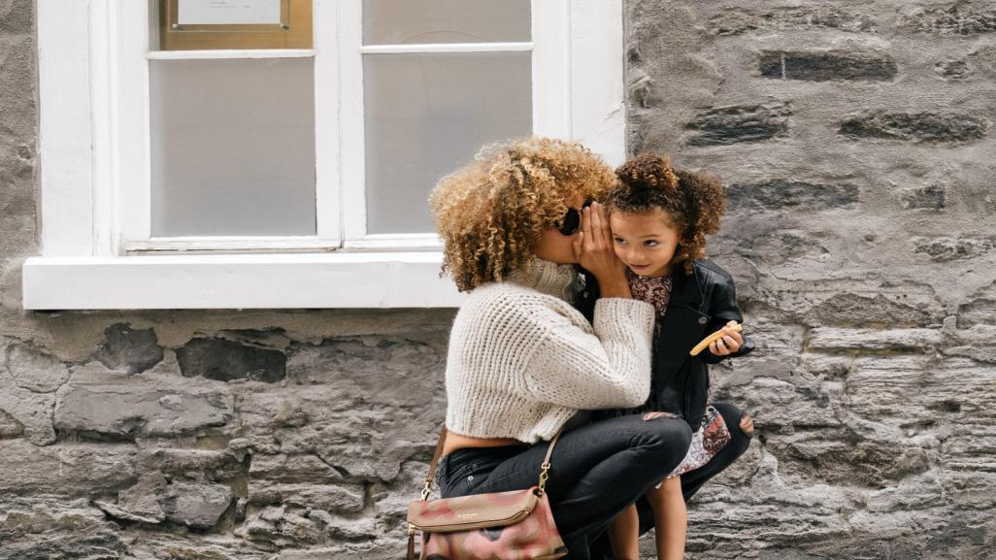
“Golden Rule”
Be considerate
Abide by the protocol
Be friendly
Practice professionalism

Slide 7
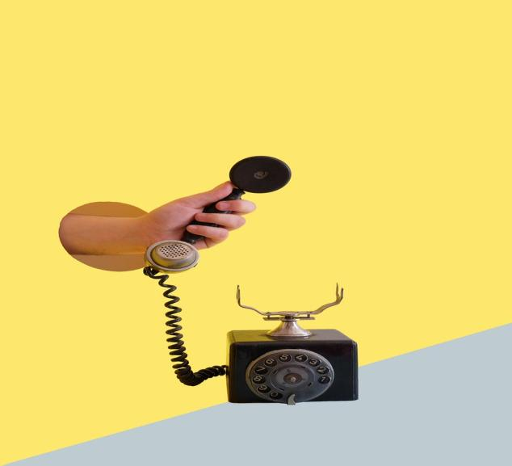
Phone Etiquette
Do’s
Answer using your name , title and ask how you can help
Always leave your phone number and speak slowly
Leave a short, detailed message
Return calls in a timely manner
Smile when you answer the phone
Don’t
Eat when you are on phone
Put someone on speakerphone
Talk with others
Say anything that you don’t want the caller to hear
Answer the phone if you are not prepared
Answer calls when you are in office or in a meeting

Slide 8
E-mail Etiquette
Subject line should be short and specific
Avoid jargon and abbreviations
Use short paragraph
Read for content and grammar before sending
Be consistent with format
Think before you hit “send”

Slide 9
Announcement
Dress code for Company secretaries
Dress code for a CS appearing before Judicial/Quasi – Judicial bodies and Tribunals like NCLT – NCLAT, etc.
The council has approved the following Guidelines for Professional Dress Code for Company secretaries to appear before judicial/ quasi-judicial bodies and tribunals like NCLT – NCLAT, SAT etc.:
S. No. | Guidelines
1. | For Male Members: a. Navy Blue Suit (Coat & Trouser) with CS logo, Insignia OR Navy Blue Blazer over a sober colored Trouser b. Neck Tie (ICSI) c. White full sleeve Shirt. d. Formal Black Leather Shoes (Shined)
2. | For Female Members: Navy Blue corporate suit (Coat & Trouser), could be with a neck tie / Insignia OR b. Saree/ any other dress of sober color with Navy Blue Blazer with CS logo c. A sober footwear like shoes/ Bellies/ Wedges, etc (Shined)
3. | Members in Employment – As prescribed in 1 or 2 above
Members are advised to strictly adhere to the Dress Code prescribed by the Council

Slide 10
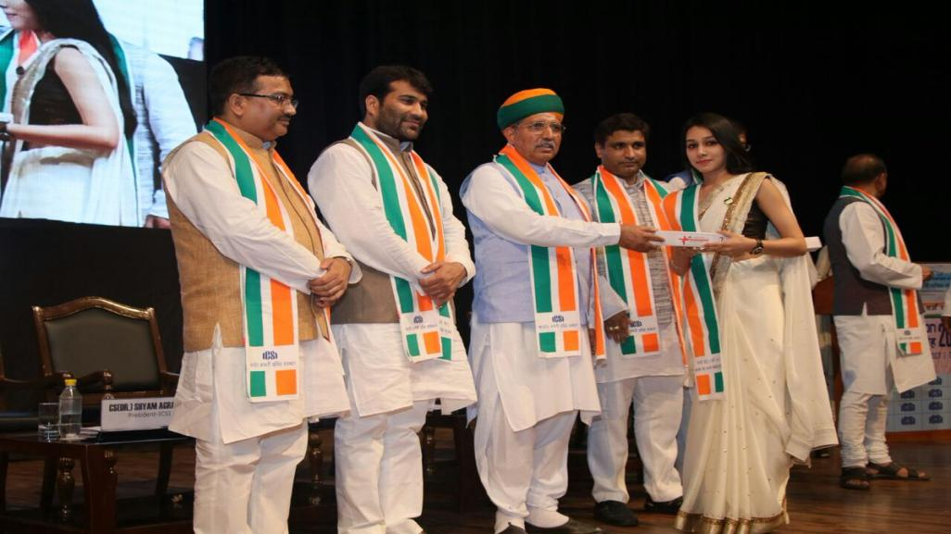
(Dr.) Shyam Agrawal, Immediate past President ICSI had adopted traditional attire as its Convocation Dress Code and has decided to do away with the western attire of gowns and caps that students used to adorn so far during the convocation ceremonies. The dress code for The ICSI Convocation is now Kurta Pyjama for boys and saree/suit for girls. The Institute has also introduced a specially designed Angavastra or stole/ Uttariya made of Khadi for its students and is a part of the official dress code for the ceremony.

Slide 11
Office space Etiquette
Don’t interrupt
Ask permission
Don’t touch
Cubicles do have walls

Slide 12
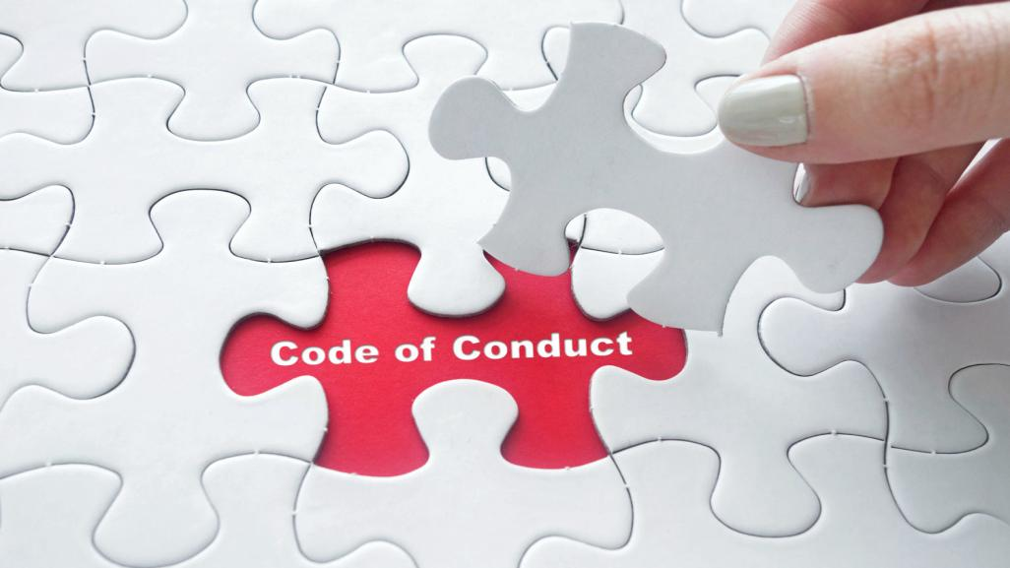
The Company Secretaries Act, 1980:
Chapter V – Section 21 to 22E
First Schedule
Second Schedule
The Company Secretaries (Procedure of Investigations of Professional and Other Misconduct and Conduct of Cases) Rules, 2007

Slide 13
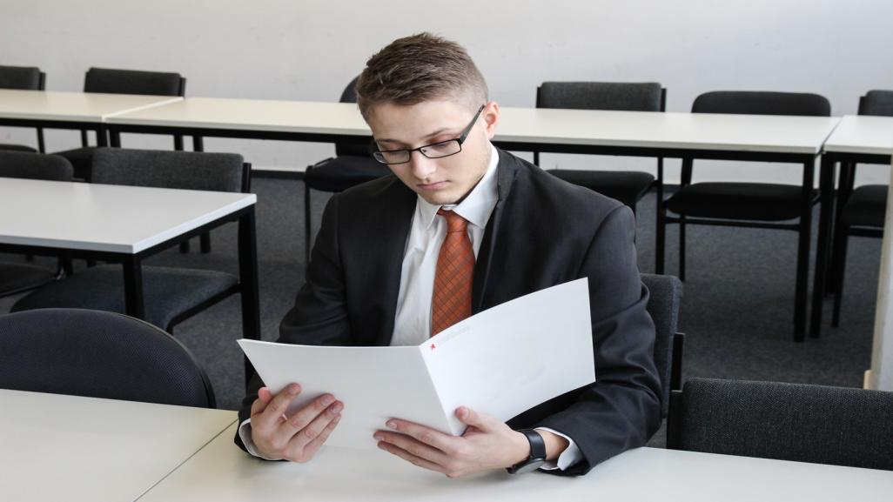
Interview Etiquette
Before the Interview
During the Interview
After the Interview
Your hair should be clean and combed.
Nails should be clean and trimmed.
Arrive at least 10 minutes before your interview. The extra minutes will also give time to fill out any forms or applications that might be required.
Turn off your cell phone or at least turn onto vibrate mode.
Don't assume that whoever greets you is the receptionist.
Make a positive and professional first impression by being assertive and giving a firm handshake to each interviewer and addressing each interviewer by name as he or she is introduced.
Reinforce your professionalism and your ability to communicate effectively by speaking clearly and avoiding "uhs", "you know", and slang.
Use appropriate working. You won't receive extra points for each work that has more than 10 letters. Use technical terms only when appropriate to the question.
Shake each interviewer's hand and thank each interviewer by name.
Send a thank you note as soon after the interview as possible

Slide 14
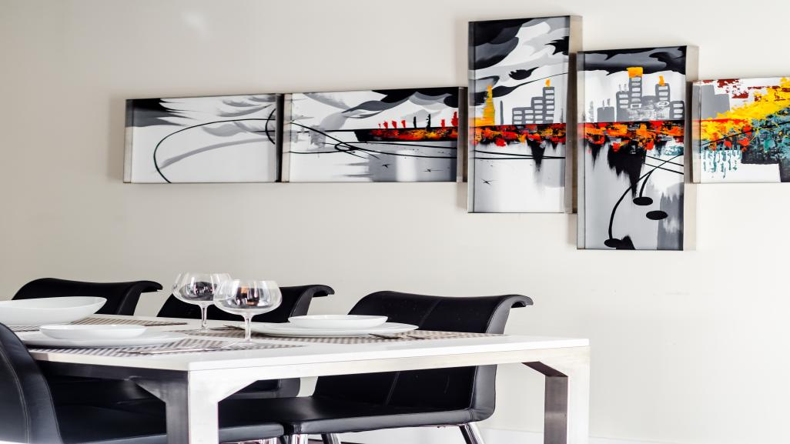
Dining Etiquette:
You must wash and dry your Hands before proceeding to eat.
Unlike western culture, Indian Food is served in one go.
Proper use of Cutlery
Use the Right Hand
Finishing Food
Leaving the Table

Slide 15
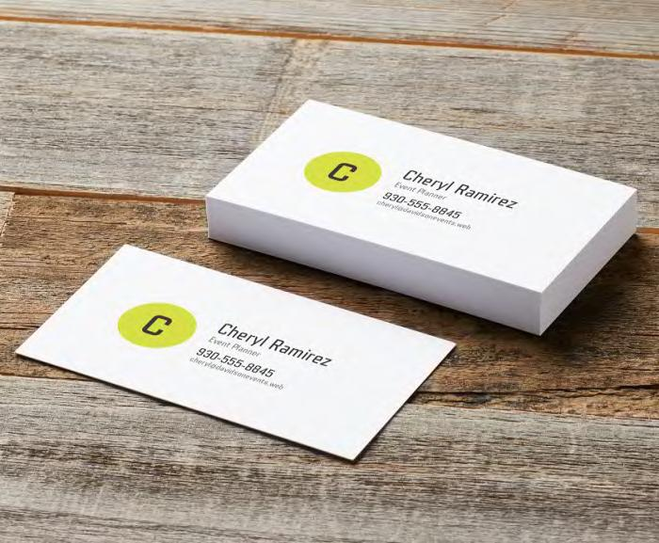
Business Card Etiquette
Never leave your home or office without your cards and plenty of them.
Keep Them Clean and Secure in a case/holder.
Present It With Two Hands & Give the card so the person who is receiving it can read it without having to turn it around.
Pause to Look at It and Note the logo, the business name or some other piece of information when you receive any Visiting Card . This places value on the card.
Keep your business cards up to date.
Don’t write notes to yourself on someone else’s business card during the exchange unless they appear relevant.
Reciprocate

Slide 16
Conclusion
By observing common courtesy and good manners, you can impress not only your boss but everyone around them in the workplace. This will add to your credentials and help you climb up the corporate ladder.

