Slide 1


GST w.e.f.-01-Jul-2017

Slide 2
Introduction of GST
Input Tax Credit Under GST
Types of Invoices
Tax Heads for Accounting
Setoff of Taxes Paid
Due Dates of Returns
Outcome of GST Council Meeting

Slide 3
GOODS AND SERVICE TAX-GST
Under GST, There are 4 types of taxes
CGST- Central Goods and Service Tax
SGST- State Goods and Service Tax
IGST- Integrated Goods and Service Tax
UTGST-Union Territory Goods and Service Tax
How will above taxes Charged
CGST and SGST will charged when supply is made in intrastate
IGST will charges when supply is made in interstate
UTGST will charged by Union Territories like Andaman and Nicobar Islands, Chandigarh, Dadra and Nagar Haveli, Daman and Diu, Delhi (National Capital Territory of Delhi), Lakshadweep, Punducherry etc.

Slide 4
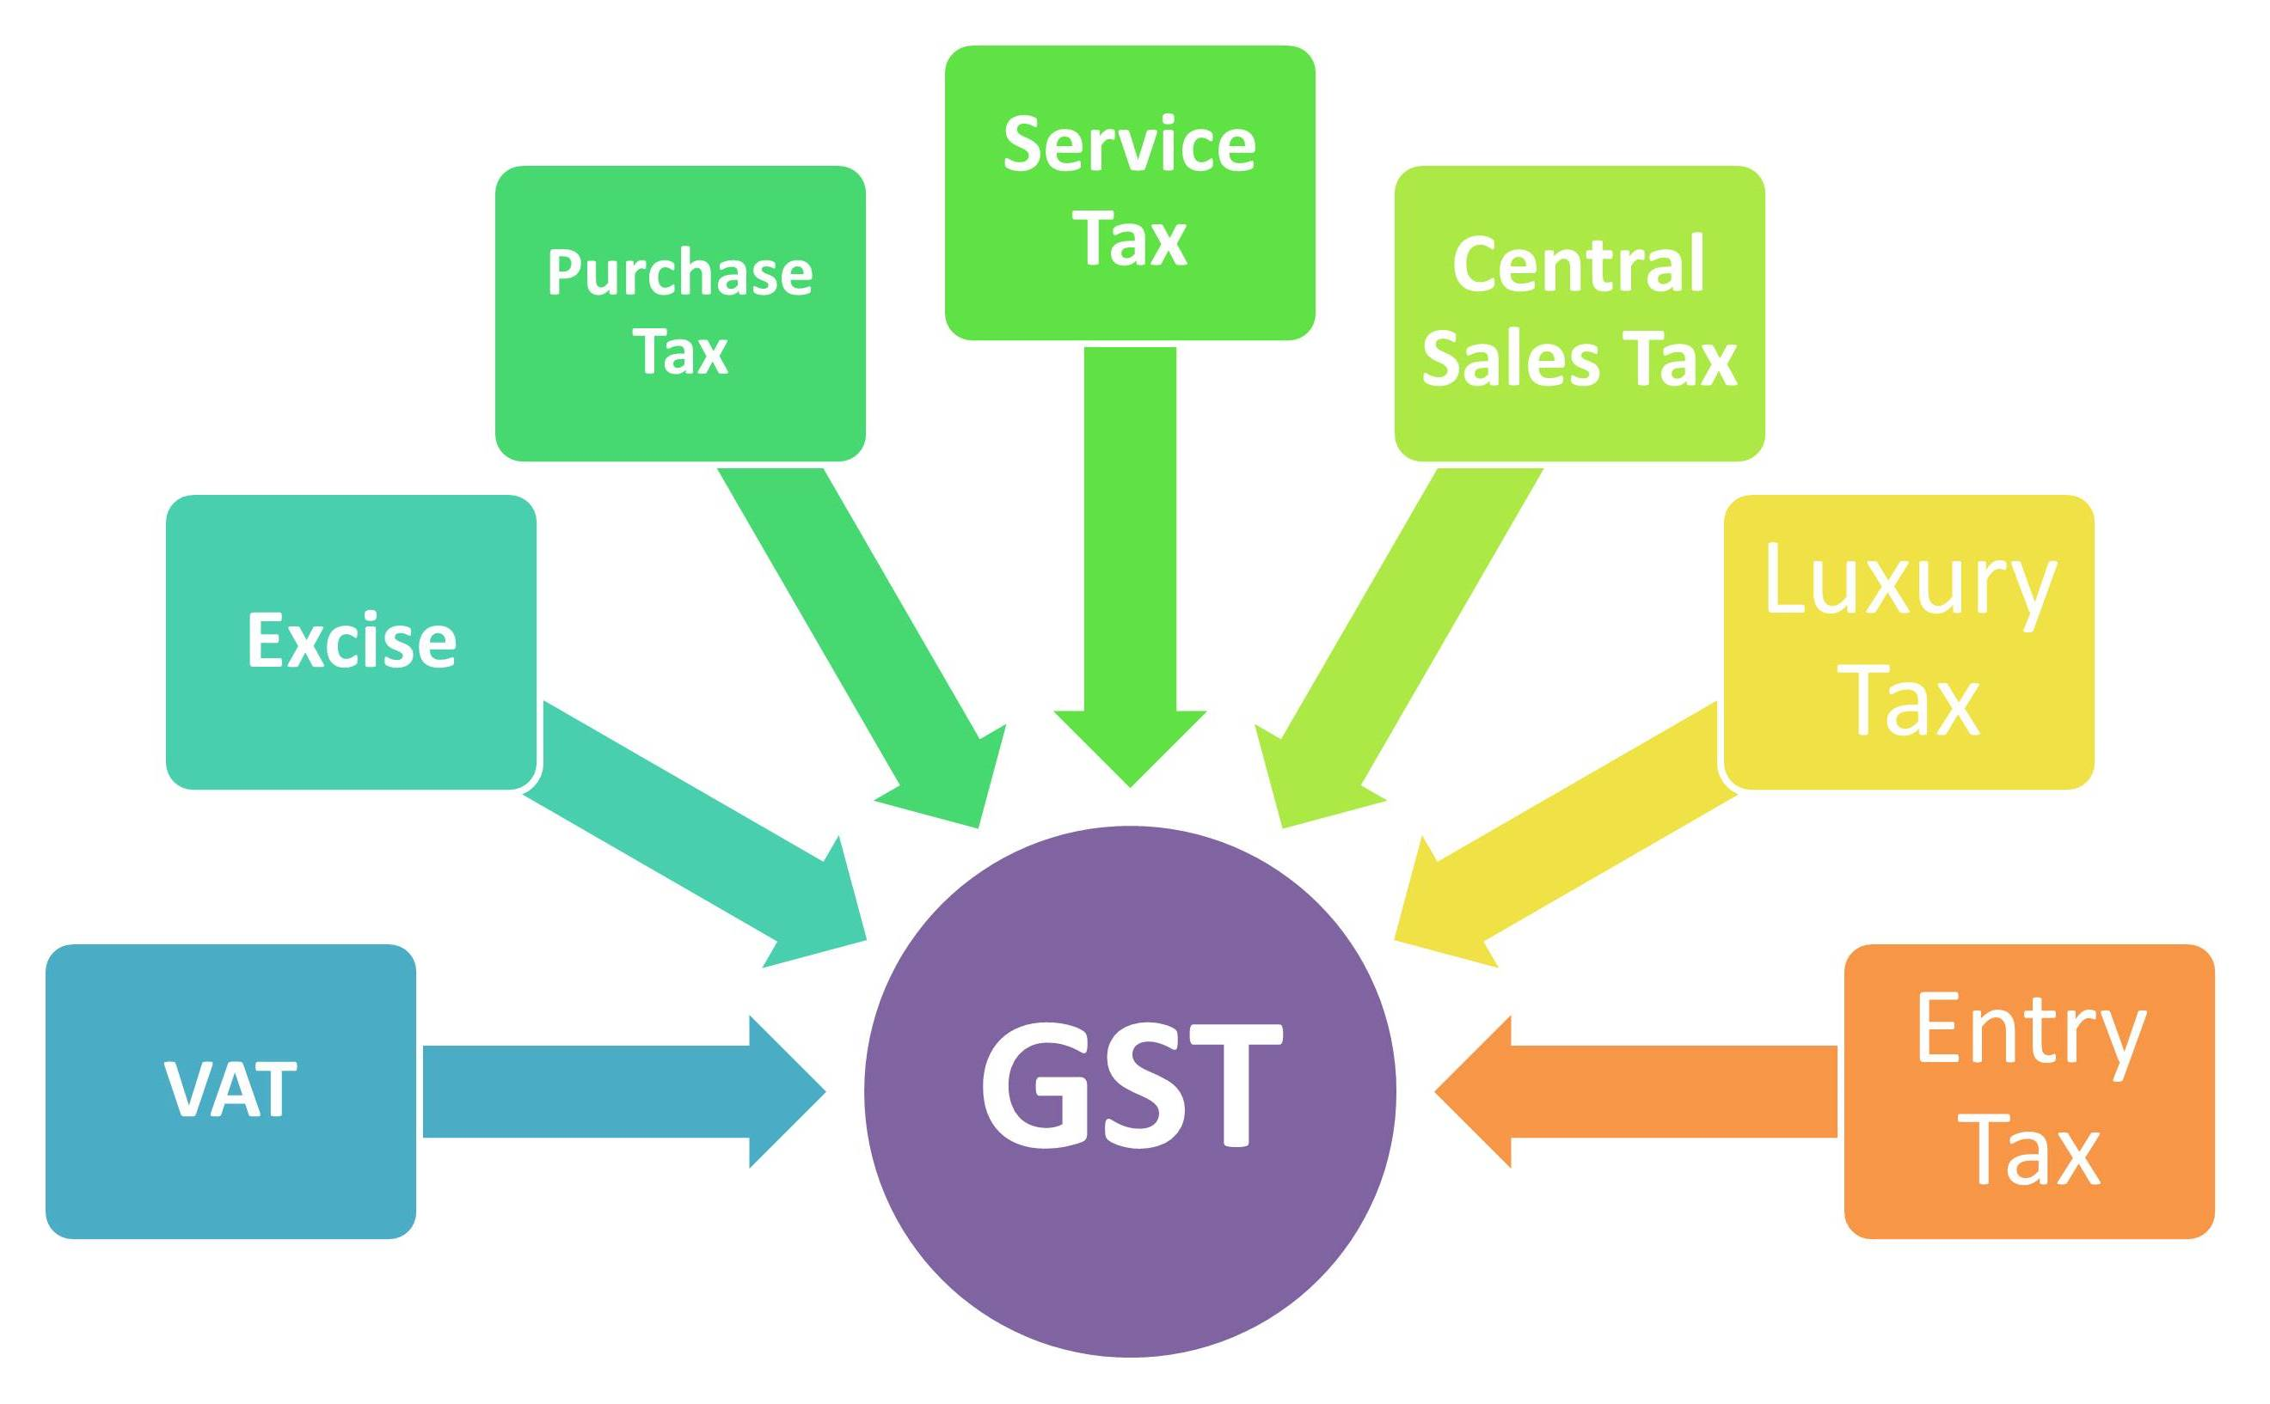
UNDER GST FOLLOWING TAX SUBSUMED

Slide 5
DEFINATIONS:
Registered Dealer- one who is registered under GST or having provisional ID.
Unregistered Dealer- one who is not registered under GST or not having provisional ID.
RCM- If any goods or services obtain from unregistered, then we need to pay tax under RCM (Reverse Charges Mechanism)
E-way Bill- is an electronic way bill for movement of goods which can be generated on the GSTN portal

Slide 6
RATES UNDER GST-:
3 % on all Interstate and Intra state Supply of Goods i.e. Polished Diamond
0.25 % on all Interstate and Intra state Supply of Goods i.e. Rough Diamond
Branch transfer is now taxable
5% on job work charges- (earlier there is not any taxes on Job work)
18% on supply of service.
RCM (Goods as well as Services)-items are same as in Service tax.
Eg. If we received any professional fees from unregistered, then we need to paid GST under RCM.

Slide 7
INPUT TAX CREDIT UNDER GST
Will get all input tax credit except which is blocked for credit
Input tax credit on RCM on payment basis
Input tax credit on capital goods also
No input tax credit on composition tax paid
Blocked credit for setoff:
On purchase of Motor vehicles
Food and beverages, outdoor catering
Membership of a club, health and fitness centre
Rent-a-cab, life insurance and health insurance.

Slide 8
TYPES OF INVOICES UNDER GST
Sr. No. | Type | Description
1 | Tax Invoice | By Registered person , if supply is taxable
2 | Bill of Supply | By registered person to un reg. or to reg. person, when supply of exempted goods or service
3 | Export Invoice | By Registered person to customer outside India
4 | Receipt Voucher | When Advance payment is received (GST Attract)-also required mention of advance recd on tax invoice
5 | Refund Voucher | When taxable supply not made against advance received
6 | Payment Voucher | Under RCM, for payment to unregistered person
7 | Revised Tax Invoice | Within one month from the date of issue of the registration certificate to already issued tax invoice
8 | Debit Note/Credit Note | If any deficiency found in a tax invoice already issued
Note: Standard contains for above invoice are mention in Tax Invoice rules

Slide 9
TAX HEADS FOR ACCOUNTING
Input CGST a/c
Output CGST a/c
Input SGST a/c
Output SGST a/c
Input IGST a/c
Output IGST a/c
Electronic Cash Ledger (to be maintained on Government GST portal to pay GST)
Electronic credit ledger

Slide 10
ACCOUNTING ENTRIES UNDER GST
Example 1: Intra-state
Mr. X purchased goods Rs. 1,00,000 locally (intrastate)
He sold them for Rs. 1,50,000 in the same state
He paid legal consultation fees Rs. 5,000
He purchased furniture for his office for Rs. 12,000
Assuming CGST @8% and SGST@8%
1) Purchase A/c Dr 1,00,000
Input CGST A/c Dr 8,000
Input SGST A/c Dr 8,000
To Creditors 1,16,000
2) Debtors A/c Dr 1,74,000
To Sales 1,50,000
To Output CGST A/c 12,000
To Output SGST A/c 12,000

Slide 11
ACCOUNTING ENTRIES UNDER GST CONT…
3) Legal Fees A/c Dr. 5,000
Input CGST A/c Dr 400
Input SGST A/c Dr 400
To Bank 5,800
4) Furniture A/c Dr 12,000
Input CGST A/c Dr 960
Input SGST A/c Dr 960
To Bank 13,920
Total Input CGST=8,000+400+960= Rs. 9,360
Total Input SGST=8,000+400+960= Rs. 9,360
Total output CGST=12,000
Total output SGST=12,000
Therefore Net CGST payable=12,000-9,360=2,640
Net SGST payable=12,000-9,360=2,640

Slide 12
ACCOUNTING ENTRIES UNDER GST CONT…
5) Output CGST A/c Dr. 12,000
Output SGST A/c Dr 12,000
To Input CGST A/c 9,360
To Input SGST A/c 9,360
To Electronic Cash Ledger 5,280
Thus due to input tax credit, tax liability of Rs. 24,000 is reduced to only Rs.5,280. Also, GST on legal fees is also adjusted which was not possible in current tax regime.
If there had been any input tax credit left it would have been carried forward to the next year.

Slide 13
SETOFF OF TAXES PAID
Order of setoff is as follow
IGST = IGST CGST SGST
CGST = CGST IGST
SGST = SGST IGST
Cross utilisation of SGST against CGST and vice versa is not allowed
If cash payment for IGST, CGST, SGST made, than inter head of cash payment is not allowed, even intra head is also not allowed.
If we wrongly made cash payment against IGST, instead of CGST,SGST, then we need to paid again against our liability and claim refund for wrong payment.

Slide 14
DUE DATES FOR FILING RETURNS
Sr. No. | Forms | Description | Due date
1 | GSTR-1 | Outward supplies of taxable Goods and Services | 10th of Next Month
2 | GSTR-2 | Inward supplies of taxable Goods and Services | 15th of Next Month
3 | GSTR-3 | Monthly Return | 20th of Next Month
4 | GSTR-9 | Annual Return | 31st Dec of Next F.Y.
5 | GSTR-3B | For July and Aug-2017 | 20th Aug, 20th Sep
6 | GSTR-1 | For July and Aug-2017 | 6-10th Sep for July 21-25th Sep for Aug
Note:
1) we need to file 37 return in a year, against 14 return in current tax regime.
2) No late fees and penalty would be levied for the interim period.

Slide 15
PROCEDURE FOR GST RETURNS
We file our outward return GSTR-1(i.e. line by line items of Invoices with HSN code)by 10th of next month
Buyer will check our data in GSTR-2A
Our buyer approves the sale and file GSTR-2
If buyer mark any changes, we can see in GSTR-1A
We can accept or deny any changes made by buyer
When buyer and seller approve, GSTR-3 will auto Generate with payment of taxes by 20th of next Month.

Slide 16
OUTCOME OF 17TH GST COUNCIL MEETING HELD ON DT. 18TH ,JUN-2017
GST Council decided that for 1st two months of GST, tax would be payable on a simple return.
Return will contains summary of outward, inward supplies which will be submitted before 20th of succeeding month.
No late fees & penalties will be levied for interim period.
GST network to take 4-5 months to prepare E-way Bill. Till then alternative or transient rule will prevail.
Simplified summary return (GSTR 3B) for the first 2 Months:
For the first two months of GST implementation, the tax would be payable based on a simple return (Form GSTR-3B containing summary of outward and inward supplies which will be submitted before 20th of the succeeding month. It means, all the supplies need to filed up anyway as expected, but the things are bit simpler. But don’t get relaxed, we need to record each & every transaction for future disclosure.

Slide 17

Manoj Malu
+91-9967239349
manojmalu7584@gmailcom

