Slide 1
GST
Payments of Taxes
Part-1

Slide 2
Ledger Involved in GST Payment
Electronic Tax Liability Register- GST payable will be maintained in this register.
Electronic Credit Ledger- GST input available will be recorded in this ledger like-Purchase of goods & Services.
Electronic Cash Ledger- GST paid in Cash will be recorded in this ledger i.e. Liability- Input= Payable.

Slide 3
1. Electronic Tax Liability Register
Electronic Tax Liability Register -The electronic liability register specified under sub-section (7) of section 49 shall be maintained in FORM GST PMT-01 for each person liable to pay tax, interest, penalty, late fee or any other amount on the Common Portal and all amounts payable by him shall be debited to the said register.
Section 49 (7)- All Liabilities of a taxable person under this act shall be recorded and maintained in an electronic liability register in such manner as may be prescribed.

Slide 4
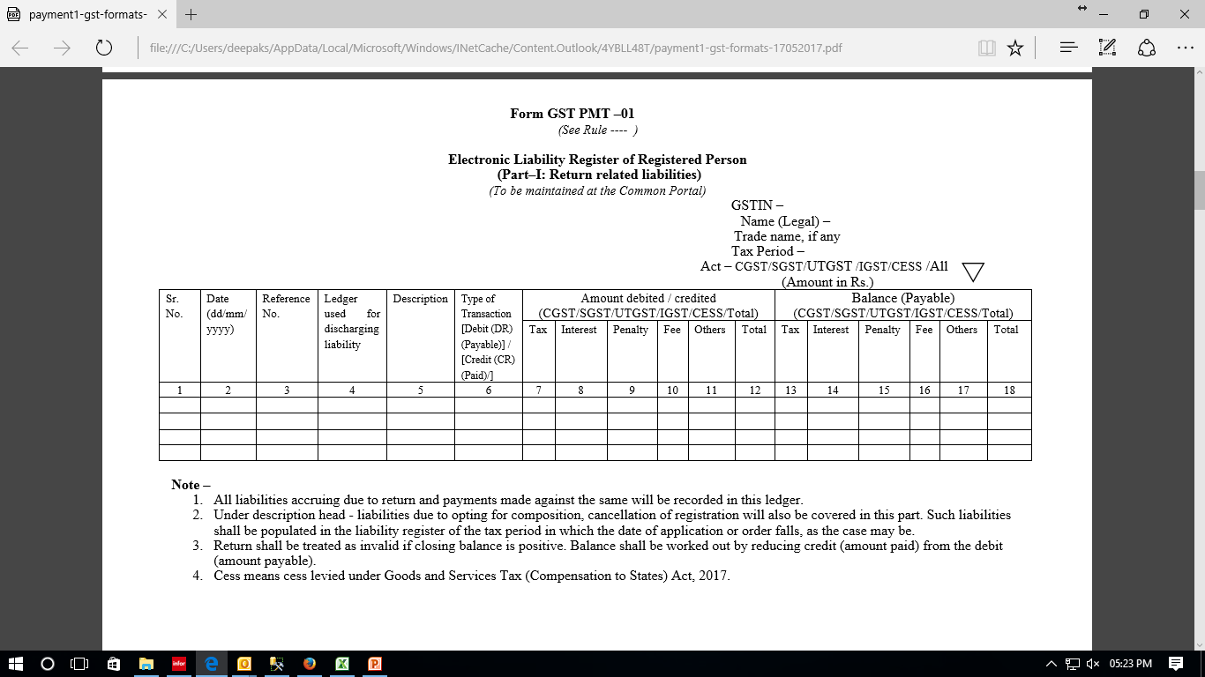

Slide 5
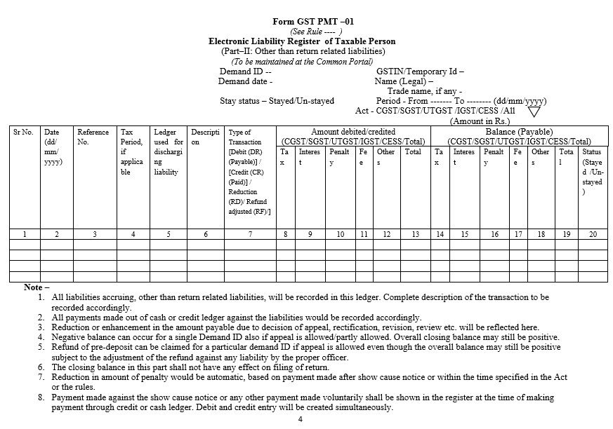

Slide 6
Misc. Points Related to Payment
(1) A unique identification number shall be generated at the Common Portal for each debit or credit to the electronic cash or credit ledger, as the case may be.
(2) The unique identification number relating to discharge of any liability shall be indicated in the corresponding entry in the electronic liability register.
(3) A unique identification number shall be generated at the Common Portal for each credit in the electronic liability register for reasons other than those covered under sub-rule (2).

Slide 7
List of Forms

Slide 8
THANKS
Subscribe the channel
For more update
By. CA. Mohit Goyal
Partner- P K M G & Associates
support@tipsntricksguru.com
goyalmohit28@gmail.com

